Slide 1
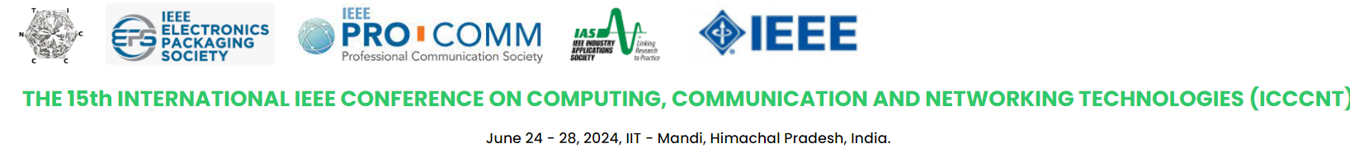

Brain Tumour Classification Using Convolutional Neural Network
P. ANJI REDDY,
UG Student,
Vel Tech Rangarajan Dr. Sagunthala R&D Institute of Science and Technology.
MANIDEEP.N,
UG Student,
Vel Tech Rangarajan Dr. Sagunthala R&D Institute of Science and Technology.
SAI MOKSHITHA .P,
UG Student,
Vel Tech Rangarajan Dr. Sagunthala R&D Institute of Science and Technology.
M.PANDIYARAJAN,
Assistant Professor,
Vel Tech Rangarajan Dr. Sagunthala R&D Institute of Science and Technology.
Dr. R.S. VALARMATHI,
Dean SoEC,
Vel Tech Rangarajan Dr. Sagunthala R&D Institute of Science and Technology.

Slide 2
OUTLINE
Introduction
Literature Review
Abstract
Objectives of the Proposed work
Implementation methodology
Results and Discussion
Conclusion and Future work
References

Slide 3
Introduction
A Convolutional Neural Network (CNN) is a type of Deep Learning neural network architecture commonly used in Computer Vision. Computer vision is a field of Artificial Intelligence that enables a computer to understand and interpret the image or visual data.
The development of brain tumors due to irregular cell growth, emphasizing the critical need for early identification to prevent adverse outcomes. Diverse tumor types, such as sarcomas, gliomas, and thyroid tumors, present varying challenges.
Meningiomas , predominant in epithelial cells of the brain and spinal cord, are mostly benign . Gliomas, located in the brain's substance, pose a threat to life expectancy, particularly with larger tumor sizes.
Pituitary tumors, originating in the anterior pituitary, can lead to abnormal hormone production, manifesting in different shapes and sizes . Magnetic Resonance Imaging (MRI) is a widely employed diagnostic tool, utilizing sagittal, axial, and crustal views.

Slide 4
Literature Review
S . No | TITLE | PUBLISHER & YEAR | METHOD | ADVANTAGE & DISADVANTAGES
1 | Advancements in Brain Tumor Classification with Pretrained Convolutional Neural Networks | Publisher: IEEE Xplore Year: 2021 | Transfer learning for Brain tumor classification using pretrained CNNs | Unlocking Precision: Benefits of Pre-trained CNNs in Medical Imaging
2 | Emerging Trends in Brain Tumor Classification with Pretrained CNNs | Publisher: Springer Year: 2020 | A Comparative Study of Pretrained CNNs in Brain Tumor Classification | Harnessing the Power of Transfer Learning

Slide 5
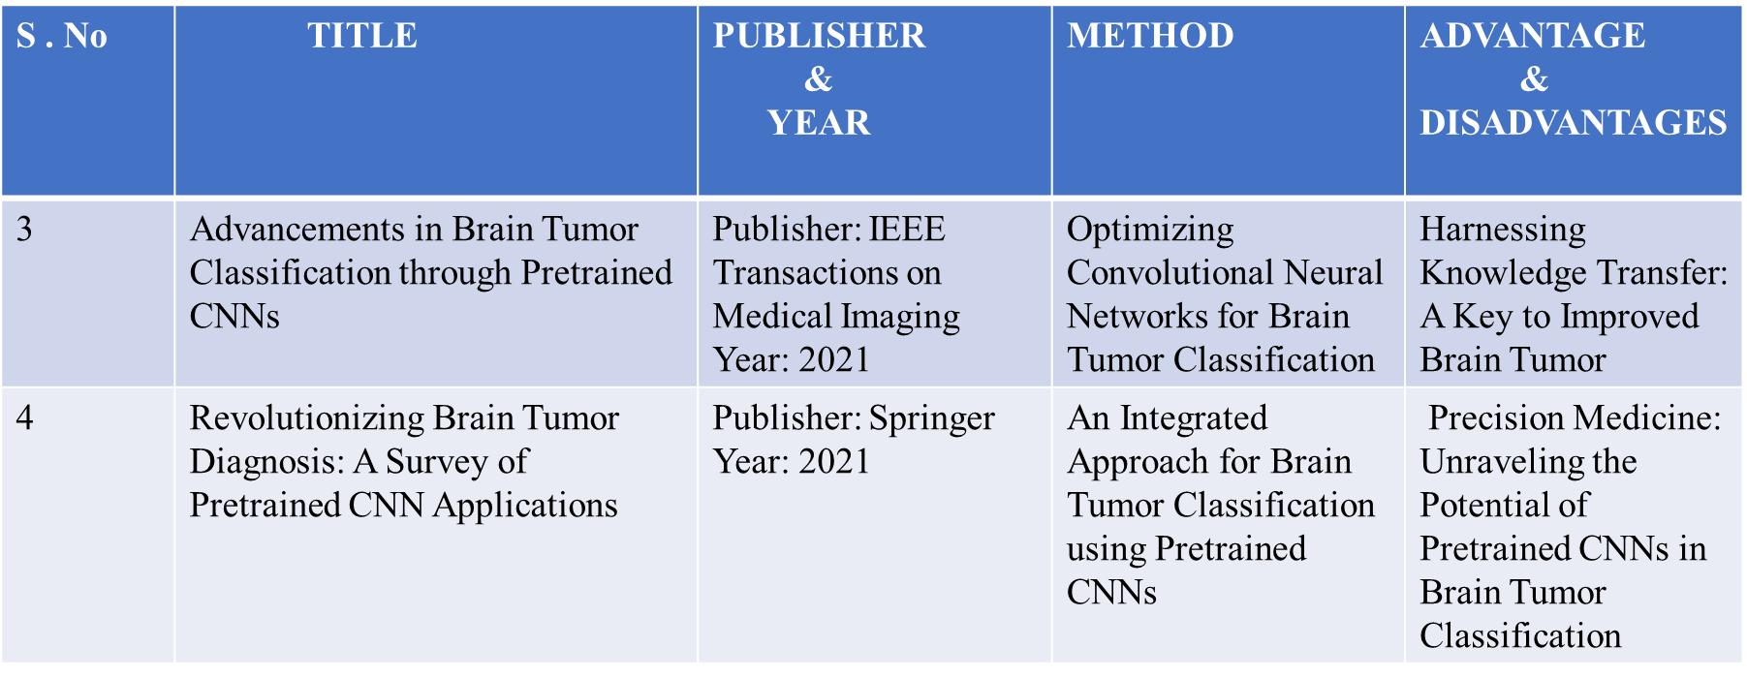
Literature Review (Contd.,)

Slide 6
Objectives
Early Identification and Classification: Develop automated segmentation mechanisms to enable early and accurate identification of various brain tumor types, including sarcomas, gliomas, and pituitary tumors
Enhanced Diagnostic Precision: Utilize machine learning algorithms to enhance the precision of brain tumor diagnosis, addressing the diverse nature of tumors in terms of sizes, shapes, and contrasts.
Efficient Imaging and Segmentation: Explore the three distinct directions of MRI (sagittal, axial, and crustal views) to optimize imaging for efficient segmentation, ensuring comprehensive coverage of the brain.
Streamlined Clinical Processes: Implement automated segmentation to streamline clinical processes, reducing the time and effort required for the manual location and classification of brain tumors in extensive medical image databases.

Slide 7
Implementation Methodology
An automated computer aided classification technique to substantiate the status of brain disorders.
Dataset/MRI/CT IMAGES/EEG Signals
Preprocessing
Feature Extraction
Classification
Performance Analysis
Fig. 1. Block diagram of proposed model

Slide 8
Implementation Methodology
Data Collection: Started by sourcing MRI data from public repositories like The Cancer Genome Atlas (TCGA) or the Brain Tumor Segmentation (BraTS) dataset.
Preprocessing: The image data is normalized by altering image intensities to a common scale, often between 0 and 1 or -1 and 1, to ensure consistent input for deep learning models. Applied bias field correction techniques to remove intensity inhomogeneities in MRI scans. Resized images to a standard size, typically 224x224 or 256x256, to match pretrained model requirements. Images are cropped to focus on regions of interest, such as the brain area, to minimize irrelevant background data. Applied various transformations to augment the dataset involves rotating images at different angles to simulate varied orientations , horizontally or vertically flipping images to increase diversity, scaling images to simulate different distances from the scanner, adding 11 random noise to simulate variations in image quality. The dataset is spitted into training, validation, and test sets.

Slide 9
Implementation Methodology-Model selection

Slide 10
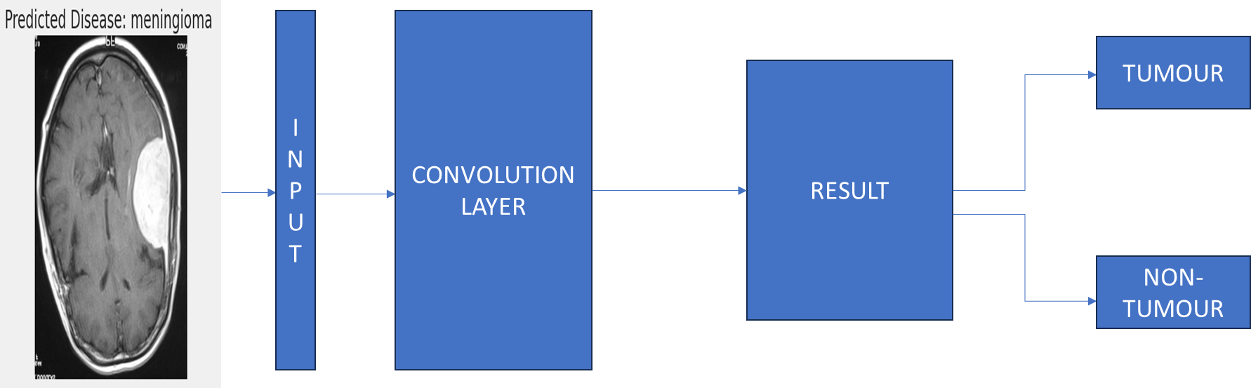
Implementation Methodology
Fig. 2. Flowgraph of the proposed work

Slide 11
Results and Discussion
Types | Precision | Recall | F1_score | Support
Glioma | 0.98 | 0.92 | 0.95 | 149
Meningioma | 0.87 | 0.96 | 0.91 | 169
No-tumor | 0.98 | 0.96 | 0.97 | 199
Pituitary | 0.98 | 0.94 | 0.96 | 139
Accuracy | - | - | 0.95 | 656
Macro avg | 0.95 | 0.95 | 0.95 | 656
Weighted avg | 0.95 | 0.95 | 0.95 | 656
Table 1 Performance Analysis of proposed model

Slide 12
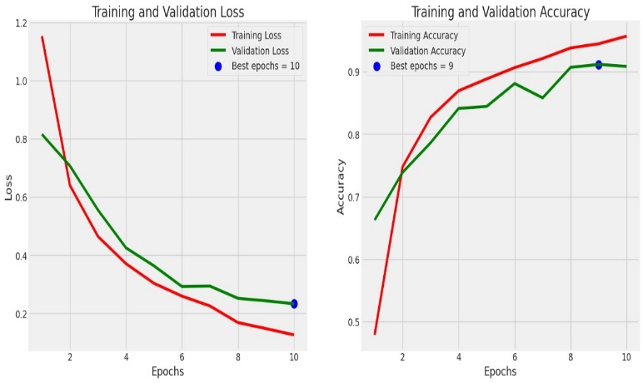
Results and Discussion
Fig. 3. Training and Validation Loss and Accuracy graph with 10 epoch

Slide 13
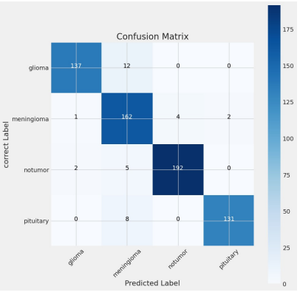
Results and Discussion
Confusion Matrix
Fig. 4. Confusion Matrix of proposed work

Slide 14
Results and Discussion
From TABLE I., the model overall accuracy of 95% further validates the robustness of the model in discriminating between tumor and non-tumor cases.
These results demonstrate that the CNN model achieves high accuracy and good performance across different tumor types. However, further analysis of the confusion matrix a shown in Fig. 4., might reveal areas where the model can be improved, such as reducing misclassifications between certain tumor types
From Fig. 3, it is evident that the model accuracy increases and loss decreases as epoch increases and given the best epoch which increases efficiency of the model.

Slide 15
CONCLUSION AND FUTURE WORK
In this research paper, we examine the use of deep learning techniques brain tumor classification model using pre-trained deep learning techniques have yielded promising results indicative of its potential in clinical practice. Through the utilization of CNNs, the model demonstrates high precision, recall, and F1-score values across diverse tumor types, including glioma, meningioma, pituitary tumors, and cases without tumors.
Further optimization of model architectures, incorporation of multi-modal imaging data, and exploration of novel deep learning techniques can further enhance the accuracy and robustness of brain tumor classification models.

Slide 16
References
[1] LeCun, Y., Bengio, Y., & Hinton, G. (2015). Deep learning. Nature, 521(7553), 436–444.
[2] Havaei, M., Davy, A., Warde-Farley, D., Biard, A., Courville, A., Bengio, Y., Pal, C., Jodoin, P. M., & Larochelle, H. (2017). Brain tumor segmentation with deep neural networks. Medical Image Analysis, 35, 18–31.
[3] Bakas, S., Akbari, H., Sotiras, A., Bilello, M., Rozycki, M., Kirby, J. S., Freymann, J. B., Farahani, K., & Davatzikos, C. (2018). Advancing the Cancer Genome Atlas glioma MRI collections with expert segmentation labels and radiomic features. Scientific Data, 4, 170117.
[4] Litjens, G., Kooi, T., Bejnordi, B. E., Setio, A. A. A., Ciompi, F., Ghafoorian, M., ... & Sánchez, C. I. (2017). A survey on deep learning in medical image analysis. Medical image analysis, 42, 60-88.
[5] Havaei, M., Davy, A., Warde-Farley, D., Biard, A., Courville, A., Bengio, Y., ... & Pal, C. (2017). Brain tumor segmentation with deep neural networks. Medical image analysis, 35, 18-31.
[6] Zacharaki, E. I., Wang, S., Chawla, S., Soo Yoo, D., Wolf, R., Melhem, E. R., & Davatzikos, C. (2009). Classification of brain tumor type and grade using MRI texture and shape in a machine learning scheme. Magnetic resonance in medicine, 62(6), 1609-1618.
[7] Pereira, S., Pinto, A., Alves, V., & Silva, C. A. (2016). Brain tumor segmentation using convolutional neural networks in MRI images. IEEE transactions on medical imaging, 35(5), 1240-1251.
[8] Zhou, Z., & Rahman Siddiquee, M. M. (2018). A review on deep learning techniques for the diagnosis of brain tumor. Neurocomputing, 286, 340-348.
[9] Mobadersany, P., Yousefi, S., Amgad, M., Gutman, D. A., Barnholtz-Sloan, J. S., Velázquez Vega, J. E., ... & Brat, D. J. (2018). Predicting cancer outcomes from histology and genomics using convolutional networks. Proceedings of the National Academy of Sciences, 115(13), E2970-E2979.
[10] Chang, P., Grinband, J., Weinberg, B. D., Bardis, M., Khy, M., Cadena, G., ... & Filippi, C. G. (2018). Deep-learning convolutional neural networks accurately classify genetic mutations in gliomas. American Journal of Neuroradiology, 39(7), 1201-1207.
[11] Isensee, F., Kickingereder, P., Wick, W., Bendszus, M., & Maier-Hein, K. H. (2018). Brain tumor segmentation and radiomics survival prediction: Contribution to the BRATS 2017 challenge. In International MICCAI Brainlesion Workshop (pp. 287-297). Springer, Cham.
[12] Ravi, D., Wong, C., Deligianni, F., Berthelot, M., Andreu-Perez, J., Lo, B., & Yang, G. Z. (2017). Deep learning for health informatics. IEEE journal of biomedical and health informatics, 21(1), 4-21.
[13] Paul, R., Banerjee, S., & Konar, A. (2019). An efficient brain tumor detection model using deep convolutional neural network. Journal of Ambient Intelligence and Humanized Computing, 10(2), 595-605.
[14] Bhatia, S., Abrol, A., & Kumar, V. (2019). Review of brain tumor detection and classification using deep learning convolutional neural network. Multimedia Tools and Applications, 78(20), 29589-29605.
[15] Chang, K., Balachandar, N., Lam, C., Yi, D., Brown, J., Beers, A., ... & Rubin, D. (2018). Distributed deep learning networks among institutions for medical imaging. Journal of the American Medical Informatics Association, 25(8), 945-954.

Slide 17
References
[16] Asri, H., Mousannif, H., Moatassime, H. A., Noel, T., & Haddadi, E. (2016). Using machine learning algorithms for breast cancer risk prediction and diagnosis. Procedia Computer Science, 83, 1064-1069.
[17] Choi, Y. S., Park, S. K., Jang, J. Y., Kim, H. W., Kim, S. H., & Park, S. H. (2018). Prediction of high-grade prostate cancer using DCE-MRI radiomics features. Physics in Medicine & Biology, 63(5), 05LT01.
[18] Li, Z., Wang, Y., Yu, J., Guo, Y., Cao, W., Huang, Y., ... & Ye, Q. (2018). Deep learning based radiomics (DLR) and its usage in noninvasive IDH1 prediction for low grade glioma. Scientific reports, 8(1), 1-11.
[19] He, K., Zhang, X., Ren, S., & Sun, J. (2016). Deep residual learning for image recognition. In Proceedings of the IEEE conference on computer vision and pattern recognition (pp. 770-778).
[20] Chowdhury, M. E. H., Rahman, M. M., Khandakar, A., Islam, K. R., Khan, M. A. A., & Al-Emadi, N. (2018). Can AI help in screening viral and COVID-19 pneumonia?. IEEE Access, 8, 132665-132676.
[21] Kumar, N., Verma, R., Sharma, S., Bhargava, S., Vahadane, A., & Sethi, A. (2017). A dataset and a technique for generalized nuclear segmentation for computational pathology. IEEE transactions on medical imaging, 36(7), 1550-1560.
[22] Lundervold, A. S., & Lundervold, A. (2019). An overview of deep learning in medical imaging focusing on MRI. Zeitschrift für Medizinische Physik, 29(2), 102-127.
[23] Hosny, A., Parmar, C., Quackenbush, J., Schwartz, L. H., & Aerts, H. J. (2018). Artificial intelligence in radiology. Nature Reviews Cancer, 18(8), 500-510.
[24] Koohbanani, N. A., & D. O. Glocker, B. (2019). Deep learning in mammography and breast histology, a review. In ECR (Vol. 2019).
[25] Thévenaz, P., Ruttimann, U. E., & Unser, M. (1998). A pyramid approach to subpixel registration based on intensity. IEEE Transactions on Image Processing, 7(1), 27-41.
[26] Lecun, Y., Bottou, L., Bengio, Y., & Haffner, P. (1998). Gradient-based learning applied to document recognition. Proceedings of the IEEE, 86(11), 2278-2324.
[27] Szegedy, C., Liu, W., Jia, Y., Sermanet, P., Reed, S., Anguelov, D., ... & Rabinovich, A. (2015). Going deeper with convolutions. In Proceedings of the IEEE conference on computer vision and pattern recognition (pp. 1-9).
[28] Krizhevsky, A., Sutskever, I., & Hinton, G. E. (2012). ImageNet classification with deep convolutional neural networks. In Advances in neural information processing systems (pp. 1097-1105).

Slide 18
Thank you

